Slide 1
Comparison Between Baseline (Linear, Non-Linear) and CNN Model for Image Classification
Presented By-
Md Ulfat Tahsin - 1913057642
Nazmul Hasan Nobel - 1812424042
Farzana Rahman - 1712173642
Click here to access our Github Repository.
Date of Presentation: 29-Aug-22

Slide 2
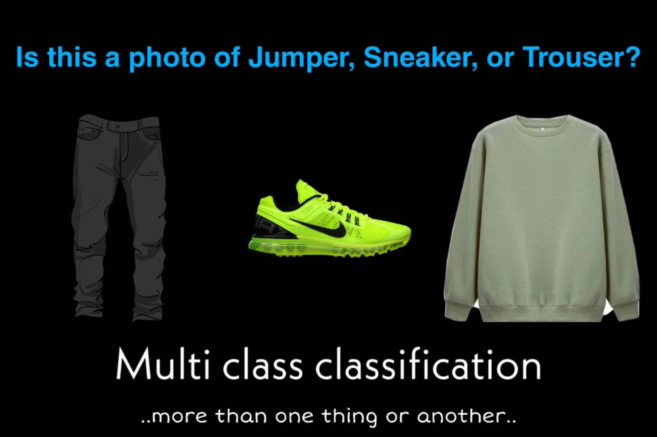
1. What is the problem?
Performance and evaluation of garment classification models.

Slide 3
2. What models did we use to solve it?
Linear Model 0 Layers
1 Flatten
2 Linear
Non-linear Model 1 Layers
1 Flatten
1 Linear
1 ReLU activation
1 Linear
1 ReLU activation
Logistic Regression Model 2
1. Generating prediction
2. Calculating loss
3. Computing gradients
4. Updating weights
5. Resetting Gradients

Slide 4
2. What models did we use to solve it ? (Cont.)
Tiny VGG Architecture - Model 3
Block 1 Layers
(3*3) Conv2d (s=1, p=1)
1 ReLU activation
(3*3) Conv2d (s=1, p=1)
1 ReLU activation
(2*2) MaxPool2d (s=2)
Block 2 Layers
(3*3) Conv2d (s=1, p=1)
1 ReLU activation
(3*3) Conv2d (s=1, p=1)
1 ReLU activation
(2*2) MaxPool2d (s=2)
Block 3 (Softmax) Layers
1 Flatten
1 Linear
© Architecture followed from CNN Explainer Tiny VGG

Slide 5
3. The training parameters: batch size, learning rate, epochs, and other optimization parameters.
Model 0(linear) and 1(non-linear)
BATCH_SIZE = 32
input_shape = 28*28
hidden_units = 10
output_shape = 10
loss_fn = CrossEntropyLoss
optimizer = SGD, lr = 0.1
epochs = 3
Logistic regression
BATCH_SIZE = 128
input_shape = 28*28
loss_fn = CrossEntropyLoss
optimizer = SGD, lr = 0.1
epochs = 3

Slide 6
4. The learning (training/validation accuracy) and time required for epochs.
Linear Model 0 (cpu)
train_loss = 0.46
train_acc = 84.44 %
test_loss = 0.48
test_acc = 83.43 %
time = 36.676 s
Nonlinear Model 1 (cpu)
train_loss = 0.67
train_acc = 75.94 %
test_loss = 0.69
test_acc = 75.02
time = 25.495 s
Logistic Regression Model 2 (cpu)
validation_loss = 0.33
validation_acc = 84.13 %
time = 20.34 s
CNN Model 3 (cpu)
train_loss = 0.33
train_acc = 84.13 %
test_loss = 0.33
test_acc = 88.07 %
time = 169.010 s

Slide 7
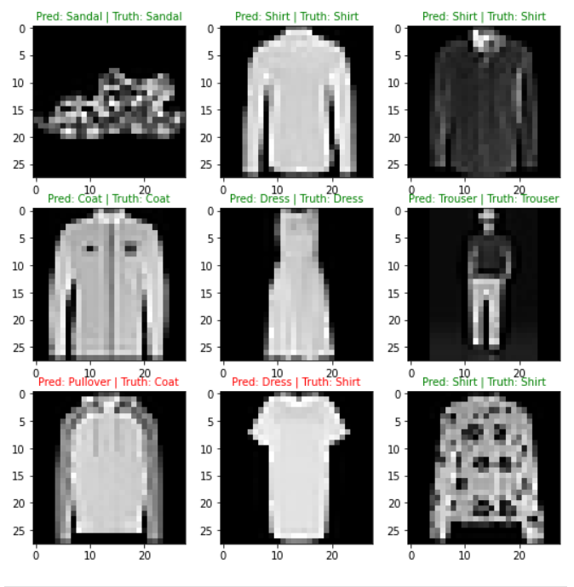
5. What did we find interesting?
Dress
or Shirt !
Coat or
Pullover !

